Slide 1
MongoDB Relations & Schema

Slide 2
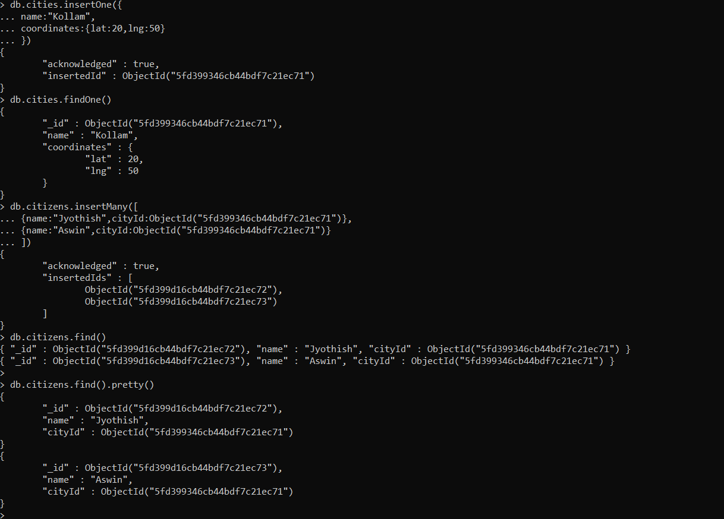
One to Many

Slide 3
One to Many

Slide 4
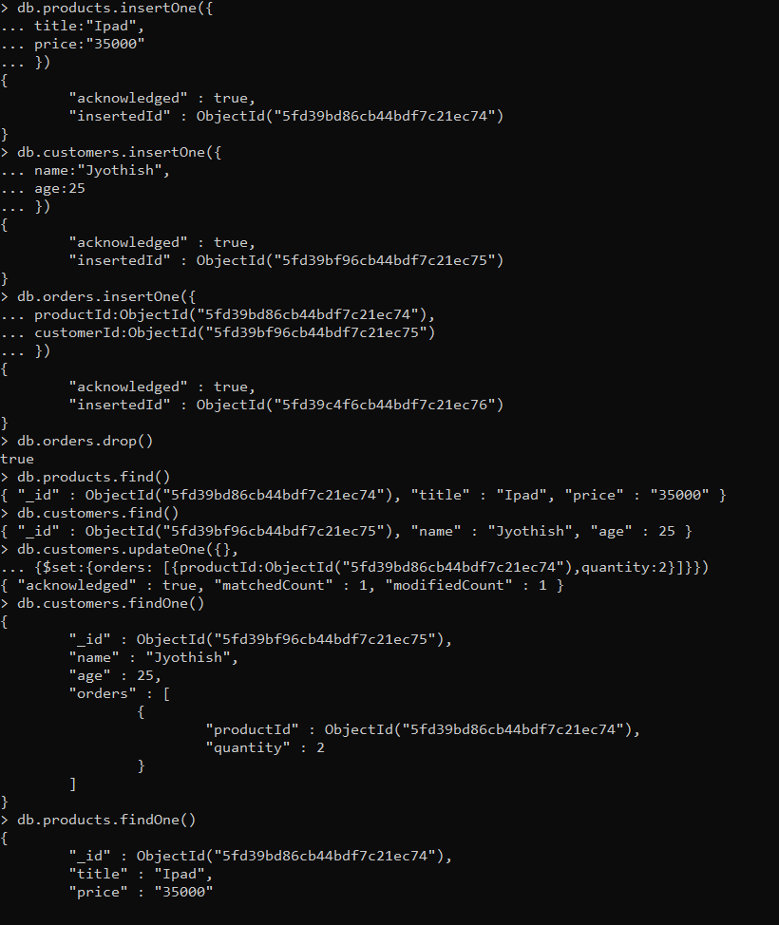
Many to Many

Slide 5
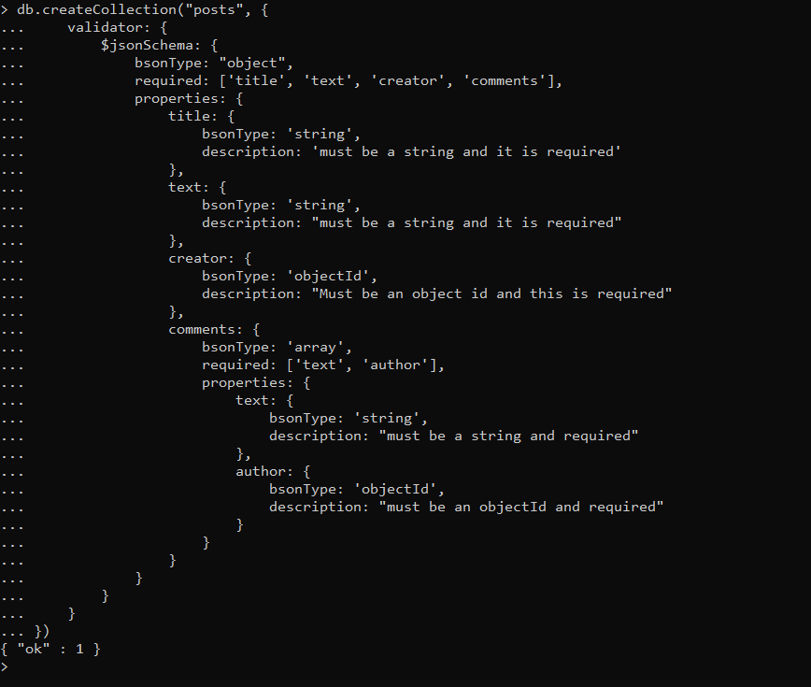
Validation Schema

